Slide 1
Software Engineering II
Lecture 31
CS61B, Fall 2023 @ UC Berkeley

Slide 2
Background
Background
The Problem
Writing Clean Code
Build Your Own World
Documentation
Q & A
Lecture 31, CS61B, Fall 2023

Slide 3


Noah Adhikari (he/him)
Stella Kaval (she/her)
Senior majoring in CS and Applied Math
First taught 61B in Spring 2022
From Torrance, California (same as Justin!)
I sneeze when I look at the sun (this is called ACHOO syndrome)
Junior majoring in CS
2nd semester on course staff for CS 61B
From SF Bay Area, CA
My favorite music artist is ABBA
Most recently used emojis: 🫶💀🫠
Notes:
To put your image in the circle - right click it and use Replace Image.

Slide 4
Today’s lecture will be primarily on how to write good code. You can apply the concepts you’ll learn today right now! They’ll also apply forever.
General Q&A will be at the very end.

Slide 5
The Problem
Background
The Problem
Writing Clean Code
Build Your Own World
Documentation
Q & A
Lecture 31, CS61B, Fall 2023

Slide 6
Technical Debt
Your work will be available to other people.
People are going to build off of it, or at least see it.
Maybe this is your future self!
Ideally, it should be flawless and well-documented.
Deadlines exist.
School deadlines, grants, conferences, reviews, etc.
Prototypical, hastily-written code is inevitable.
There is pressure to achieve both quality and quantity.
This is inarguably a tradeoff - prioritizing one will negatively affect the other.
This doesn’t just apply to code - it applies to life. 🤯
How do you deal with this? See Strategic vs Tactical Programming from SWE I.

Slide 7
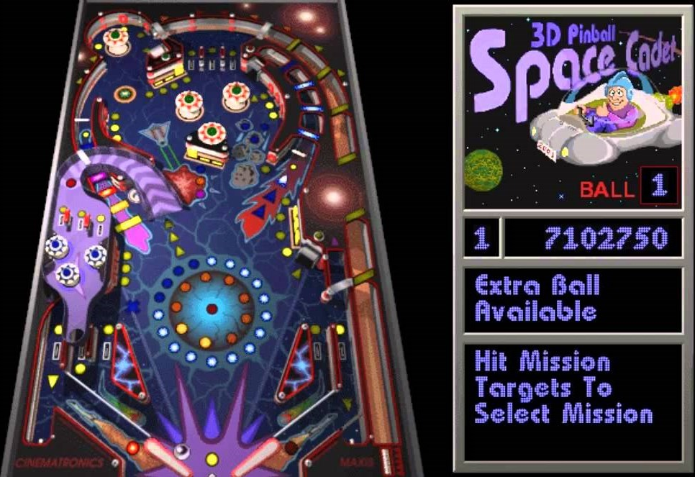
Who Cares?
You probably don’t want your work to end up like Space Cadet Pinball 👀
Notes:
Source: Full Tilt! Pinball - Wikipedia
Largely speculative, but still
Originally made by a third party.
Issue arose when porting from 32 to 64 bit.
Doesn’t exist on Windows anymore because of weird collision bug. The code was so bad they couldn’t fix it and opted to trash it for later releases of Windows.
Even Microsoft opted to throw it in the dumpster. If you’re like me you probably don’t want your hard work thrown in the dumpster

Slide 8
Writing Clean Code
Background
The Problem
Writing Clean Code
Build Your Own World
Documentation
Q & A
Lecture 31, CS61B, Fall 2023

Slide 9
IMPORTANT NOTE!
Refactoring is changing your code to make things more organized without affecting functionality.
Before refactoring, always add and commit your code! This way, you can restore your old work if necessary.
In this lecture, I won’t do this for brevity. But you should!

Slide 10
Bad Code Example 1 - What’s wrong with this?
public class Structure {
private class Brick {
Brick next;
}
public static int size(Brick b) {
if (b == null) {
return 0;
}
if (b.next == null) {
return 1;
}
return 1 + size(b.next);
}
}
What does the size method even do?
Returns the size of a Structure? A Brick in the structure?
Why is this method static?
Unnecessary base-case (arms-length recursion)
You can omit the size-1 case entirely and get the same behavior
Exposes visibility
Brick is private, but size is public and takes a Brick as input. If we want to find the size from another class, we can never actually call this method, because we can’t access Bricks!
Why do we need to compute the size like this? Can’t we just track it with an instance variable?

Slide 11
Better Code Example 1
/** Comment on what a Structure is/does. */
public class Structure {
/** Comment on what a Brick is/does. */
private class Brick {
/** Next Brick in the Structure. */
Brick next;
}
/* The first Brick in this Structure. */
private Brick head;
/* Number of Bricks in this Structure. */
private int size;
/** Returns the number of Bricks
* in this Structure. */
public int size() {
return size;
}
What does the size method even do?
Returns the size of a Structure
Maybe too many comments now?
Unnecessary base-case
We don’t even care about this anymore
Exposes visibility
Calling size doesn’t require knowing any private classes
Why do we need to compute the size like this? Can’t we just track it with an instance variable?
Yes

Slide 12
Bad Code Example 2 - What’s wrong with this?
static void print3DArray(String[][][] arrays) {
System.out.print("[");
for (int i = 0; i < arrays.length; i++) {
if (arrays[i] == null) {
continue;
}
System.out.print("[");
for (int j = 0; j < arrays[i].length; j++) {
if (arrays[i][j] == null) {
continue;
}
System.out.print("[");
for (int k = 0; k < arrays[i][j].length; k++) {
System.out.print(arrays[i][j][k]);
if (k < arrays[i][j].length - 1) {
System.out.print(", ");
}
}
System.out.print("]");
if (j < arrays[i].length - 1) {
System.out.print(", ");
}
}
System.out.print("]");
if (i < arrays.length - 1) {
System.out.print(", ");
}
}
System.out.print("]\n");
}
I have no idea what’s going on
Probably prints 3D arrays?

Slide 13
Bad Code Example 2 - Test to verify correctness as you refactor
public static void main(String[] args) {
String[][][] arrays = new String[][][] {
new String[][] {
new String[] {"1", "2", "3"},
new String[] {"4", "5", "6"},
new String[] {"7", "8", "9"}
},
null,
new String[][] {
new String[] {"10", "11", "12"},
new String[] {"13", "14", "15"},
new String[] {"16", "17", "18"}
}
};
print3DArray(arrays);
}
Small test
[[[1, 2, 3], [4, 5, 6], [7, 8, 9]], [[10, 11, 12], [13, 14, 15], [16, 17, 18]]]
Hey, it works! Why change it?

Slide 14
Bad Code Example 2 - Use the tools of the language
static void print3DArray(String[][][] arrays) {
System.out.print("[");
for (String[][] array : arrays) {
if (array == null) {
continue;
}
System.out.print("[");
for (String[] arr : array) {
if (arr == null) {
continue;
}
System.out.print("[");
for (String a : arr) {
System.out.print(a + ", ");
}
System.out.print("], ");
}
System.out.print("], ");
}
System.out.print("]\n");
}
Enhanced-for loops exist
Still bad, but much better, even with terrible variable names
Small test
[[[1, 2, 3, ], [4, 5, 6, ], [7, 8, 9, ], ], [[10, 11, 12, ], [13, 14, 15, ], [16, 17, 18, ], ], ]
Hey, you broke it! Change it back!

Slide 15
Bad Code Example 2 - Avoid “goto” statements where possible
static void print3DArray(String[][][] arrays) {
System.out.print("[");
for (String[][] array : arrays) {
if (array != null) {
System.out.print("[");
for (String[] arr : array) {
if (arr != null) {
System.out.print("[");
for (String a : arr) {
System.out.print(a + ", ");
}
System.out.print("], ");
}
}
System.out.print("], ");
}
}
System.out.print("]\n");
}
In general, this is a good idea, but it didn’t help much here…
Braces and indentation are even worse than before
Also, the code is still broken :(

Slide 16
Bad Code Example 2 - Separate logic into simple methods
static void print3DArray(String[][][] arrays) {
System.out.print("[");
for (String[][] array : arrays) {
print2DArray(array);
System.out.print(", ");
}
System.out.print("]\n");
}
static void print2DArray(String[][] array) {
if (array != null) {
System.out.print("[");
for (String[] arr : array) {
print1DArray(arr);
System.out.print(", ");
}
System.out.print("]");
}
}
static void print1DArray(String[] arr) {
if (arr != null) {
System.out.print("[");
for (String a : arr) {
System.out.print(a + ", ");
}
System.out.print("]");
}
}
Much better!
Our test still doesn’t work.
[[[1, 2, 3, ], [4, 5, 6, ], [7, 8, 9, ], ], [[10, 11, 12, ], [13, 14, 15, ], [16, 17, 18, ], ], ]
Weird comma behavior for the last element of arrays.
Notably, we have this problem for every nested array
We have identical print statements for the commas and square brackets everywhere, with similar issues for all of them.
Something like generic types would probably come in handy here, but these methods are static…
Notes:
Google how to have static generic types java

Slide 17
Bad Code Example 2 - Code generically; don’t repeat yourself
static void print3DArray(String[][][] arrays) {
printCommaSeparated(arrays);
System.out.print("\n");
}
static void print2DArray(String[][] array) {
printCommaSeparated(array);
}
static void print1DArray(String[] arr) {
printCommaSeparated(arr);
}
static <T> void printCommaSeparated(T[] arr) {
if (arr != null) {
System.out.print("[");
for (int i = 0; i < arr.length; i++) {
System.out.print(arr[i]);
if (i < arr.length - 1) {
System.out.print(", ");
}
}
System.out.print("]");
}
}
You actually can have generic static methods in Java.
[[[Ljava.lang.String;@e9e54c2, null, [[Ljava.lang.String;@65ab7765]
?!
Notes:
Google how to print arrays in java

Slide 18
Bad Code Example 2 - Don’t reinvent the wheel
static void print3DArray(String[][][] arrays) {
printCommaSeparated(arrays);
System.out.print("\n");
}
static void print2DArray(String[][] array) {
printCommaSeparated(array);
}
static void print1DArray(String[] arr) {
printCommaSeparated(arr);
}
static <T> void printCommaSeparated(T[] arr) {
if (arr != null) {
System.out.print(Arrays.toString(arr));
}
}
[[[Ljava.lang.String;@e9e54c2, null, [[Ljava.lang.String;@65ab7765]
This occurs due to the nested-ness of our problem.
This is actually pretty annoying to resolve - an exercise for the brave amongst you is to fix it without using the library solution.

Slide 19
Better Code Example 2 - Cheat Don’t reinvent the wheel, again
static <T> void printArray(T[] arr) {
System.out.print(Arrays.deepToString(arr));
}
[[[1, 2, 3], [4, 5, 6], [7, 8, 9]], null, [[10, 11, 12], [13, 14, 15], [16, 17, 18]]]
Yes, we have that null in there, but it’s totally a feature, not a bug
This now works for any amount of nested arrays. And any (non-primitive) type of array!

Slide 20
Writing Clean Code, Summary
Refactoring is hard.
No immediate clear gains to be had - it’s all investment in the future
The more stuff gets built on top of your bad code, the worse the problem becomes
It’s hard to tell what will break, and more stuff will break the longer you wait
Code cleanly from the start!

Slide 21
Writing Clean Code, Guidelines
Not a complete list!
Add and commit before and after a refactor
Understand what your code needs to do
Understand who or what needs to access your code
Avoid unnecessarily complex ways of doing things
Use descriptive method and variable names, and document your code well
Use the tools the language offers
Separate logic into simpler methods
Code generically
Don’t repeat yourself
Don’t reinvent the wheel
Google and StackOverflow are your friend

Slide 22
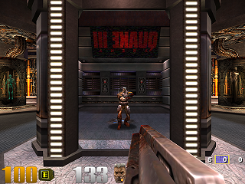
Bonus: Fast Inverse Square Root (with original comments)
float q_rsqrt(float number)
{
long i;
float x2, y;
const float threehalfs = 1.5F;
x2 = number * 0.5F;
y = number;
i = * ( long * ) &y; // evil floating point bit level hacking
i = 0x5f3759df - ( i >> 1 ); // what the fuck?
y = * ( float * ) &i;
y = y * ( threehalfs - ( x2 * y * y ) ); // 1st iteration
// y = y * ( threehalfs - ( x2 * y * y ) ); // 2nd iteration, this can be removed
return y;
}
Notes:
Fast inverse square root - Wikipedia
In 1999 people were making this game called Quake III which was a 3D arena game.
This involved lots of lighting calculations, which require this operation a TON to normalize vectors.
Not going to go into the weeds of this here, you can Google it if you want.
Hopefully your comments look better than this, and magic numbers are bad. Only in 2018 (20 years later) was a mathematical analysis found for why this number is what it is…

Slide 23
2 minute stretch break! 🙆

Slide 24
Build Your Own World
Background
The Problem
Writing Clean Code
Build Your Own World
Documentation
Q & A
Lecture 31, CS61B, Fall 2023

Slide 25
Build Your Own World
Beyond 61A & previous 61B assignments
Project 3 opens the door to more complex and creative coding 🚪✨
Teamwork
Intentionally a partner project
Focus on clean code and clear documentation for successful collaboration
It isn't good enough to write code that works
It isn’t good enough to write code quickly
You need to write code that other people can use

Slide 26
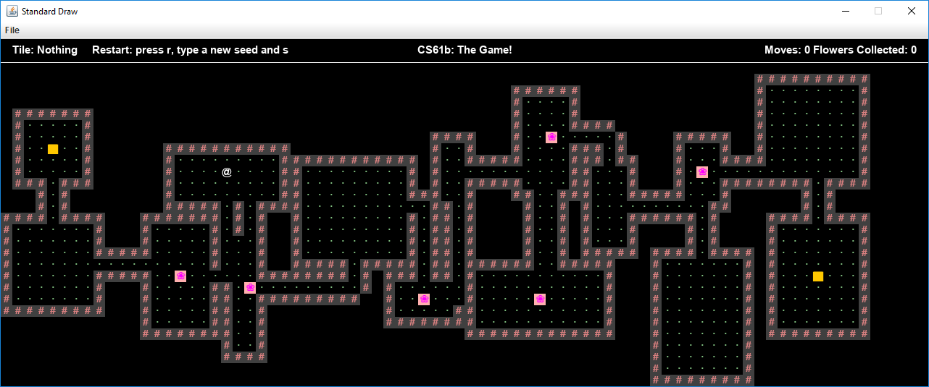
Build Your Own World
In Project 3, you’ll be building a system in two phases:
World Generation 🌎 → use a random seed to create a unique 2D world
Interactivity 🕺→ the ability for the avatar to move around in the world

Slide 27
BYOW Strategic vs. Tactical Programming
Tactical Programming focuses on immediate solutions
Strategic Programming plans ahead for future changes and scalability
Project 3 has two phases and code will be edited over many weeks 🗓️
Strategic programming simplifies the transition from phase 1 → phase 2
Now we are going to look at a few examples of tactical approaches to the project, and potential strategic fixes!

Slide 28

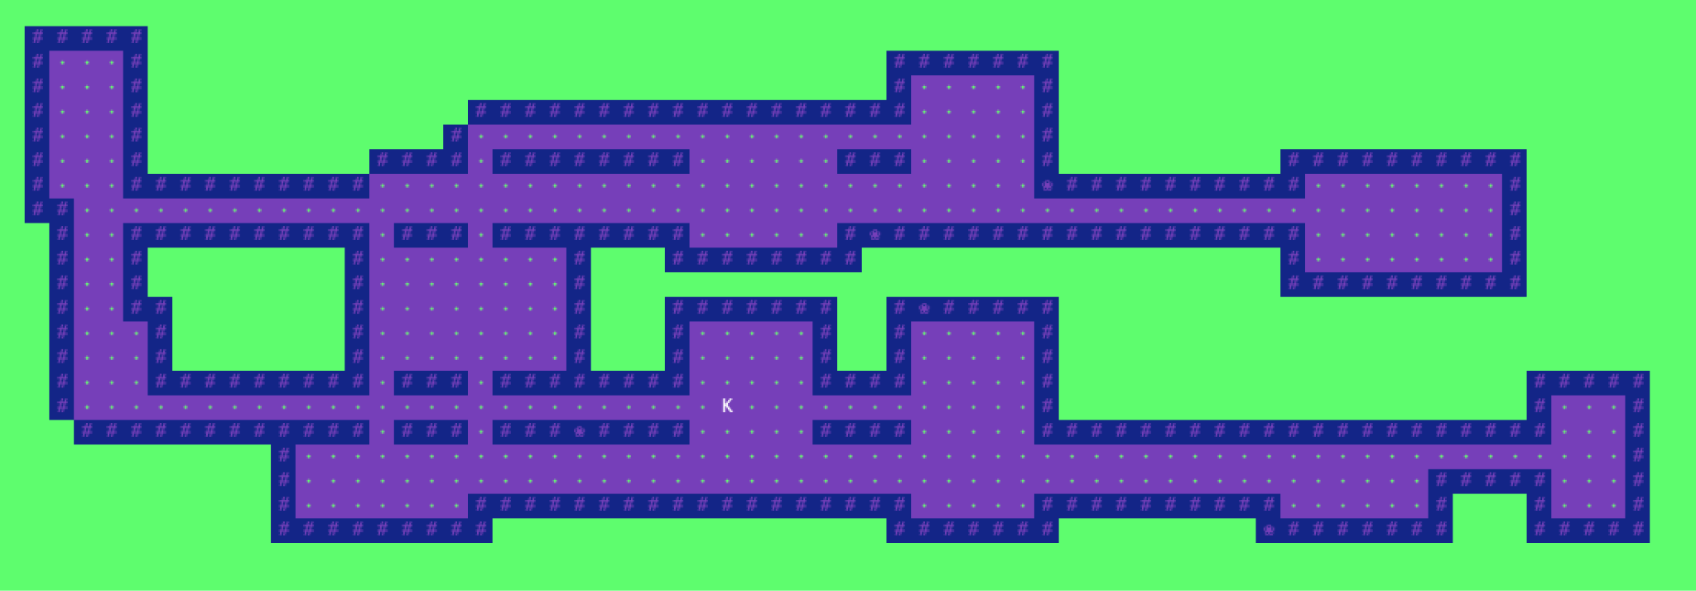
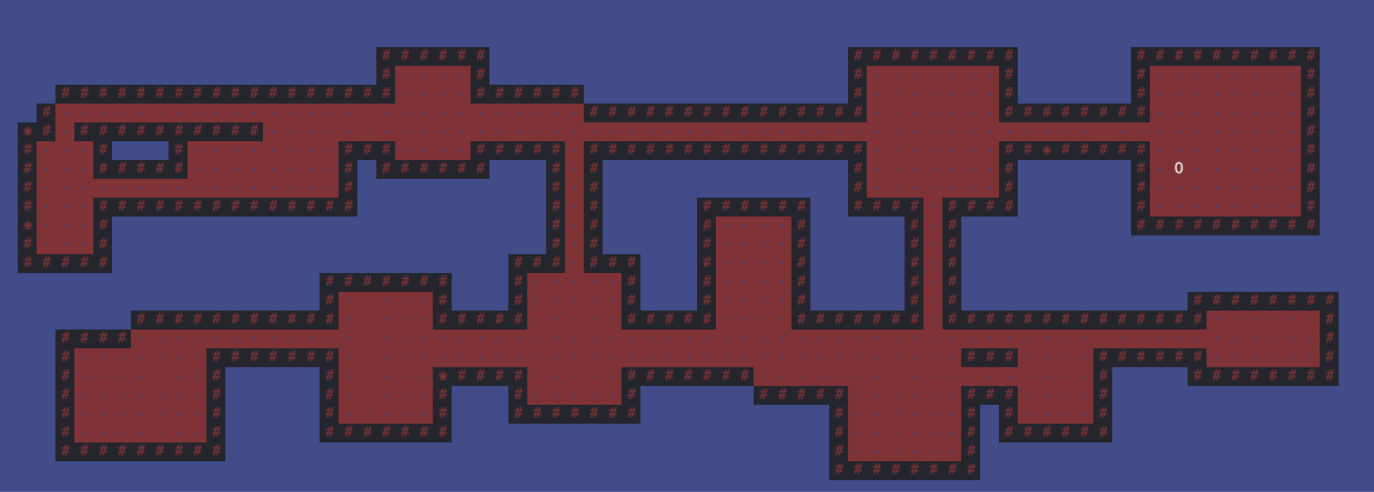
BYOW Tactical Approach Example 1
public void setTheme(String theme) {
if (theme.equals("barbie")) {
setBackground("barbieBackground.jpg");
setAvatar("barbieAvatar.png");
setMusic("barbieTheme.mp3");
}
if (theme.equals("ken")) {
setBackground("kenBackground.jpg");
setAvatar("kenAvatar.png");
setMusic("kenTheme.mp3");
}
if (theme.equals("oppenheimer")) {
setBackground("oppenheimerBackground.jpg");
setAvatar("oppenheimerAvatar.png");
setMusic("oppenheimerTheme.mp3");
}
}

Slide 29
BYOW Tactical Approach Example 1
public void setTheme(String theme) {
if (theme.equals("barbie")) {
setBackground("barbieBackground.jpg");
setAvatar("barbieAvatar.png");
setMusic("barbieTheme.mp3");
}
if (theme.equals("ken")) {
setBackground("kenBackground.jpg");
setAvatar("kenAvatar.png");
setMusic("kenTheme.mp3");
}
if (theme.equals("oppenheimer")) {
setBackground("oppenheimerBackground.jpg");
setAvatar("oppenheimerAvatar.png");
setMusic("oppenheimerTheme.mp3");
}
}
What happens when I want to add 10 new themes? 🤔
Super tedious copy-paste
Unorganized
What happens is we want themes to have different text fonts as well? 🤔
Manually copy-paste into each if statement setFont(...)

Slide 30
BYOW Strategic Approach Example 1
public void setTheme(Theme theme) {
theme.applySettings();
}
public interface Theme {
void applySettings();
}
public class BarbieTheme implements Theme {
public void applySettings() {
setBackground("barbieBackground.jpg");
setAvatar("barbieAvatar.png");
setMusic("barbieTheme.mp3");
}
}
We could design the method to accept a Theme object
Easier to add new themes
Organization improved
Requires more initial design and implementation effort

Slide 31
BYOW Tactical Approach Example 2
What is complex about this code? 🤔
if (move.equals("a")
&& !world[player.xxcenter - 1][player.ycenter].equals(Tileset.WALL)) {
player.xxcenter -= 1;
world[player.xxcenter][player.ycenter] = Tileset.PLAYER;
world[player.xxcenter + 1][player.ycenter] = Tileset.FLOOR;
steps += 1;
}
if (move.equals("s")
&& !world[player.xxcenter][player.ycenter - 1].equals(Tileset.WALL)) {
player.ycenter -= 1;
world[player.xxcenter][player.ycenter] = Tileset.PLAYER;
world[player.xxcenter][player.ycenter + 1] = Tileset.FLOOR;
steps += 1;
}
if (move.equals("d")
&& !world[player.xxcenter + 1][player.ycenter].equals(Tileset.WALL)) {
player.xxcenter += 1;
world[player.xxcenter][player.ycenter] = Tileset.PLAYER;
world[player.xxcenter - 1][player.ycenter] = Tileset.FLOOR;
steps += 1;
}

Slide 32
BYOW Tactical Approach Example 2
Repeated code and calculations for movement
if (move.equals("a")
&& !world[player.xxcenter - 1][player.ycenter].equals(Tileset.WALL)) {
player.xxcenter -= 1;
world[player.xxcenter][player.ycenter] = Tileset.PLAYER;
world[player.xxcenter + 1][player.ycenter] = Tileset.FLOOR;
steps += 1;
}
if (move.equals("s")
&& !world[player.xxcenter][player.ycenter - 1].equals(Tileset.WALL)) {
player.ycenter -= 1;
world[player.xxcenter][player.ycenter] = Tileset.PLAYER;
world[player.xxcenter][player.ycenter + 1] = Tileset.FLOOR;
steps += 1;
}
if (move.equals("d")
&& !world[player.xxcenter + 1][player.ycenter].equals(Tileset.WALL)) {
player.xxcenter += 1;
world[player.xxcenter][player.ycenter] = Tileset.PLAYER;
world[player.xxcenter - 1][player.ycenter] = Tileset.FLOOR;
steps += 1;
}

Slide 33
BYOW Tactical Approach Example 2
Variable naming
if (move.equals("a")
&& !world[player.xxcenter - 1][player.ycenter].equals(Tileset.WALL)) {
player.xxcenter -= 1;
world[player.xxcenter][player.ycenter] = Tileset.PLAYER;
world[player.xxcenter + 1][player.ycenter] = Tileset.FLOOR;
steps += 1;
}
if (move.equals("s")
&& !world[player.xxcenter][player.ycenter - 1].equals(Tileset.WALL)) {
player.ycenter -= 1;
world[player.xxcenter][player.ycenter] = Tileset.PLAYER;
world[player.xxcenter][player.ycenter + 1] = Tileset.FLOOR;
steps += 1;
}
if (move.equals("d")
&& !world[player.xxcenter + 1][player.ycenter].equals(Tileset.WALL)) {
player.xxcenter += 1;
world[player.xxcenter][player.ycenter] = Tileset.PLAYER;
world[player.xxcenter - 1][player.ycenter] = Tileset.FLOOR;
steps += 1;
}

Slide 34
BYOW Tactical Approach Example 2
Hard-coded obstacles
if (move.equals("a")
&& !world[player.xxcenter - 1][player.ycenter].equals(Tileset.WALL)) {
player.xxcenter -= 1;
world[player.xxcenter][player.ycenter] = Tileset.PLAYER;
world[player.xxcenter + 1][player.ycenter] = Tileset.FLOOR;
steps += 1;
}
if (move.equals("s")
&& !world[player.xxcenter][player.ycenter - 1].equals(Tileset.WALL)) {
player.ycenter -= 1;
world[player.xxcenter][player.ycenter] = Tileset.PLAYER;
world[player.xxcenter][player.ycenter + 1] = Tileset.FLOOR;
steps += 1;
}
if (move.equals("d")
&& !world[player.xxcenter + 1][player.ycenter].equals(Tileset.WALL)) {
player.xxcenter += 1;
world[player.xxcenter][player.ycenter] = Tileset.PLAYER;
world[player.xxcenter - 1][player.ycenter] = Tileset.FLOOR;
steps += 1;
}

Slide 35
BYOW Strategic Approach Example 2 and BYOW Suggestions
Code Reusability ♻️
Craft helper classes and methods for recurring tasks
Abstraction 🫣
Minimize the amount of public things
Once you make a public method, it's there for good
Code Organization
Arrange your code by what it does, not the order things happen
Embrace the Style Checker 🧘‍♀️
Similarly, in industry/academia, you will encounter types of guidelines
Forward-Thinking Code Planning
Prioritize long-term strategic approaches over quick fixes
Plan before your code

Slide 36
Documentation
Background
The Problem
Writing Clean Code
Build Your Own World
Documentation
Q & A
Lecture 31, CS61B, Fall 2023

Slide 37
Documentation Intro
Documentation in technology refers to various written materials that accompany software or systems
It covers a broad spectrum, including:
Code Comments
API Documentation
User Manuals
Design Specifications
Test Documents
We'll concentrate on practical documentation strategies that you can directly apply to your projects today

Slide 38
Why Documentation?
"We don't have enough time!" 🥱
Quick documentation now avoids longer explanations later
"No-one would read it anyway!" 🤓
I highly doubt it
In Project 3, your partner will benefit from reading it
Integrated documentation encourages use
"The code should be self-documenting!"👩‍💻
Would you rather read 100 lines of someone’s code or a short summary?
Documentation explains “why” and “context,” not just “how”

Slide 39
Documentation Example 1
What can we improve about this documentation? 🤔
I’m confused – are we moving trees or the player? How do we pick? 😭
Why are we including java.util.Random?
What are x and y?
/**
* Changes location of the trees in the world
* We use java.util.Random.
*/
public boolean movePlayer(int x, int y) {...}

Slide 40
Documentation Example 1
/**
* Moves the player to a specified location within the game world.
* Validates the destination and checks for bounds.
*
* @param x The x-coordinate of the destination (horizontal position).
* @param y The y-coordinate of the destination (vertical position).
* @return 'true' if the move is successful, 'false' otherwise.
* @throws OutOfBoundsException if coordinates are outside the world.
* @usage To move the player to (5, 10), call movePlayer(5, 10).
*/
public boolean movePlayer(int x, int y) {...}

Slide 41
Documentation Example 2
What can we improve about this documentation? 🤔
Um obviously… 🙄
I am not learning anything
/**
* WorldTheme class
* It represents a WorldTheme.
*/
public class WorldTheme {...}

Slide 42
Documentation Example 2
/**
* Manages game world themes (e.g., environment, color)
* Provides methods for switching themes during gameplay.
*
* @author Stella Kaval
* @version 1.0.0
* @since 2023-11-03
*/
public class WorldTheme {...}

Slide 43
Overview
Bad documentation can impact productivity in three main areas:
Searchability 🔎
Time lost in deciphering and navigating code
Might end up rewriting the same code multiple times
Collaboration 👥
You and a partner will be writing code that both of you should understand
Onboarding 🛫
Everyone’s implementations are different
In office hours, you will be onboarding course staff to your project
Industry example

Slide 44
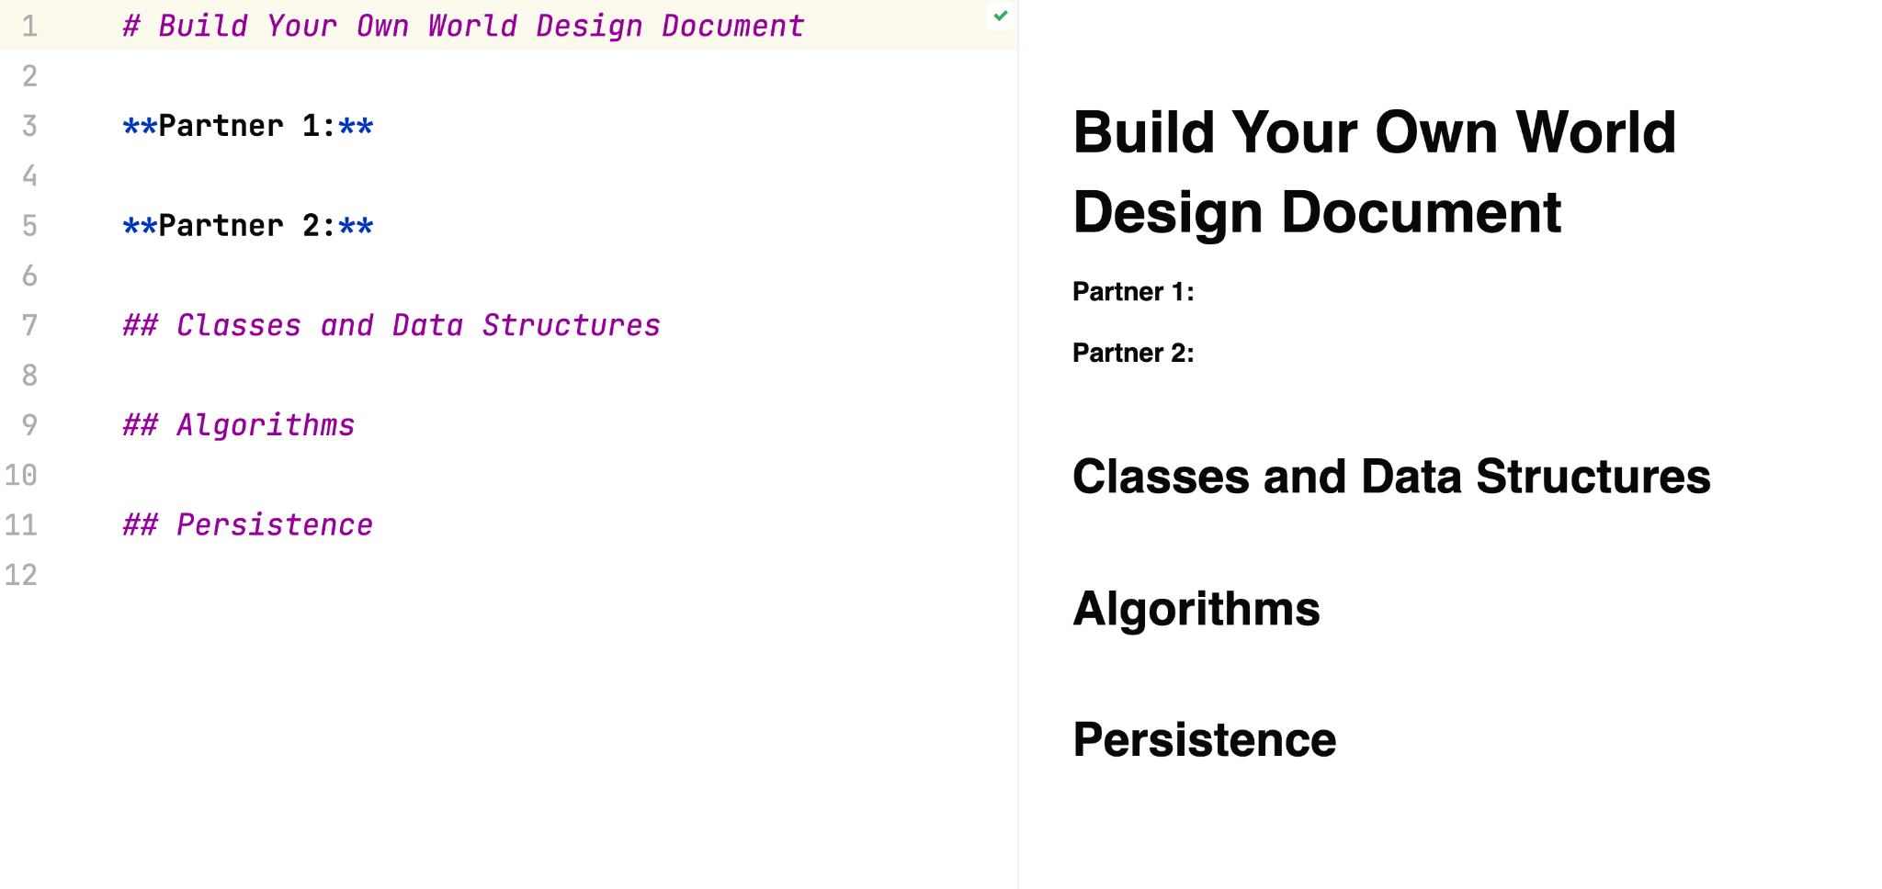
Recommendation for BYOW
Project 3 is very open-ended 😯
Pro tip: make a design document before writing a single line of code
Create a plan for every feature of your BYOW program
An iterative process – update as you go
proj3 folder → README.md

Slide 45
Q & A
Background
The Problem
Writing Clean Code
Build Your Own World
Documentation
Q & A
Lecture 31, CS61B, Fall 2023

